Slide 1
Sales Insight Data Analysis
Neha Sharma

Slide 2
Objective
To create an automated dashboard for a computer hardware business facing challenges in scaling within a dynamically changing market and lacking actionable insights.
Perform data analysis to track revenue growth, year-over-year (YOY) trends, and region-wise sales performance.
Tools Used:-
1. Microsoft Power BI
2. MySQL Workbench

Slide 3
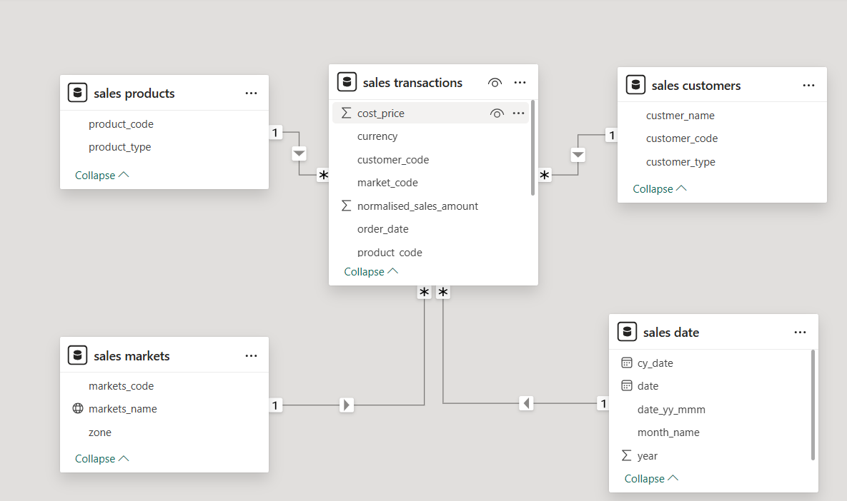
Dataset Overview

Slide 4
Business Questions
1.Revenue by market
2.Sales quantity by market
3.Revenue trend
4.Top 5 customers by revenue
5.Top 5 products by revenue
6.Total profit margin by market
7.Total profit margin by product
8.Profit margin contribution % by market
9.Profit margin % by different zones
10. Profit margin contribution % by customer
11.Profit margin contribution % by zone
12.Revenue comparison with last year revenue.

Slide 5
Key Insights
Company has generated total revenue in 4 years ₹ 985M, total profit margin ₹24.7M, Profit margin% 2.5%, Sales Qty ₹2M.
In 2020 company has generated total revenue of ₹ 142M by selling a total of 350K and earned a profit of ₹ 2.1M.

Slide 6
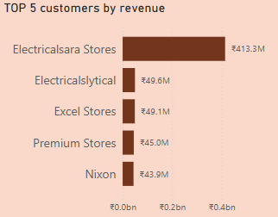
Customer Analysis
Top 5 Customers by Revenue:
Electricalsara Stores
Electricalslytical
Excel Stores
Premium Stores
Nixon

Slide 7
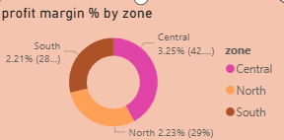
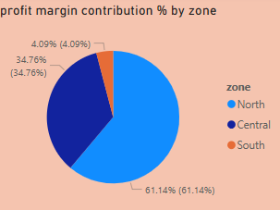
Regional Insights
Profit Margin: Central 3.25%, North 2.23% , South 2.21%
Profit margin Contribution : North zone 61.14%, Central zone 34.76% ,South zone 4%

Slide 8
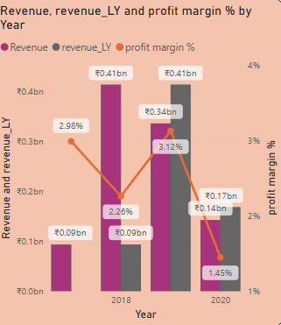
Comparative Analysis

Slide 9
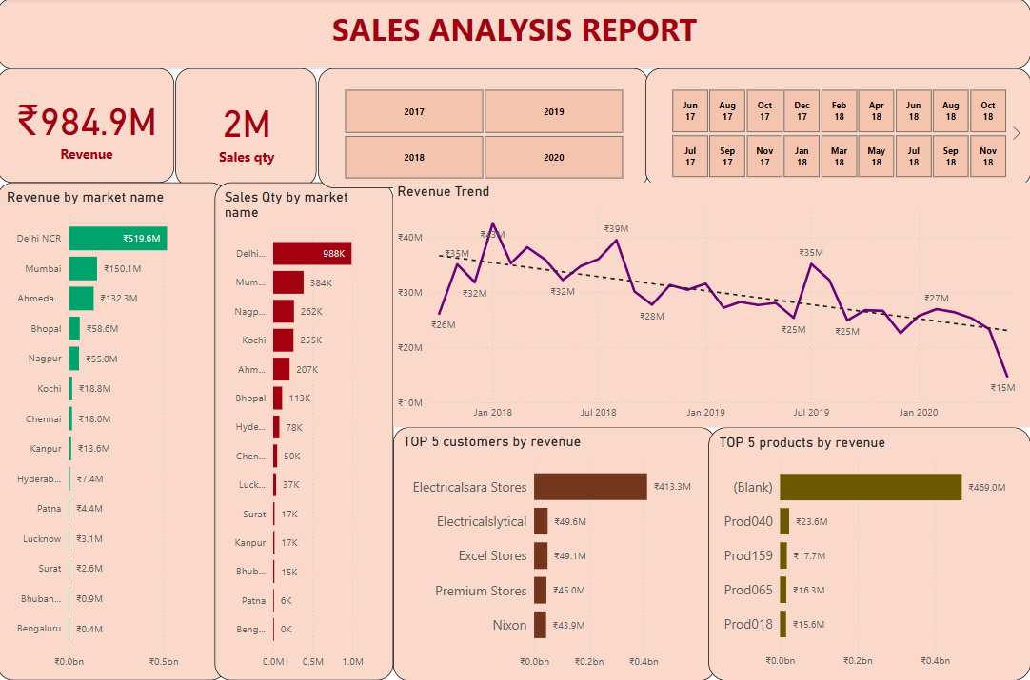
Dashboard KPI

Slide 10
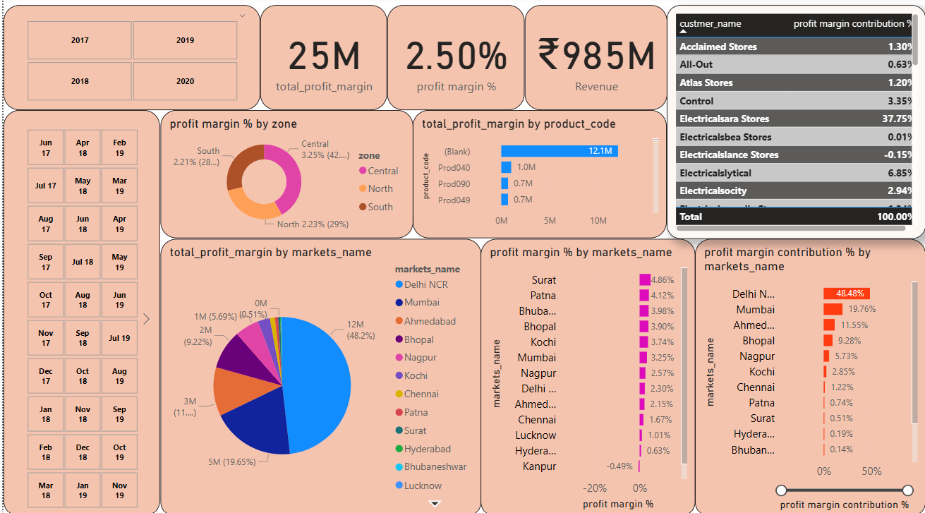
Profit Analysis

Slide 11
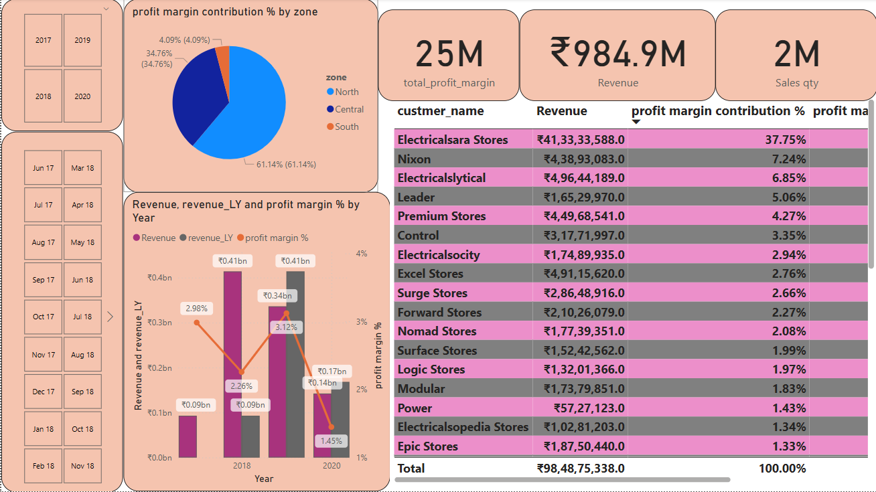
Performance Insights

Slide 12
Insights
In 4 years Delhi NCR is our largest market in terms of revenue with ₹ 520M and total contribution of 52.8% with total revenue but if you look at the profit margin Delhi NCR is generating only 2.3% profit margin.
If we check the profit margin then here In 2020 Bhubaneshwar comes into the picture which is generating the highest profit margin of 10.48%. Similarly, if we can check the Profit Contribution % by Market then here Mumbai is the largest player with 23.89% of total contribution in total profit.
In 4 years Bengaluru generating the lowest profit margin of -20.8%.if we can check the Profit Contribution % by Market then here also Bengaluru is the Lower with -0.3% of total contribution in total profit.
In our top 5 customers, the ElectricalSara Stores is our biggest customer who has generated total ₹ 413 M revenue generated in 4 years.
In our top 5 products , the Prod318 is our highest product has generated total ₹ 69M revenue generated in 4 years.
In product type Distribution has generated the revenue of ₹494M and ownbrand revenue is ₹494M generated in entire 4 years.
Revenue Trend is showing that in June 2020 revenue has been decreased drastically compared to the revenue last year and the profit margin was the least in April 2020.

Slide 13
Thank You

